Slide 1
EMTH403
Mathematical Foundation for Computer Science

Slide 2
Lecture Outcomes
understand what are Hamilton path and graphs in a directed and undirected graph.
understand what are Hamilton circuit and graphs in a directed and undirected graph.

Slide 3
Hamilton Paths and Circuits
A Hamilton path in a graph G is a path which visits every vertex in G exactly once.
A Hamilton circuit is a Hamilton path that returns to its start.

Slide 4
Travelling Salesman Problem
A Hamilton circuit or path may be used to solve practical problems that require visiting “vertices”, such as:
road intersections
pipeline crossings
communication network nodes
A classic example is the Travelling Salesman Problem – finding a Hamilton circuit.

Slide 5
Finding Hamilton Circuits
Unlike the Euler circuit problem, finding Hamilton circuits is hard.
There is no simple set of necessary and sufficient conditions, and no simple algorithm.

Slide 6
Hamilton circuit?
Ques:- Does the graph above has an Hamilton Circuit?
Sol:- a, b, c, d, e, a is a Hamilton circuit.

Slide 7
Hamilton Path?
Ques:- Does the graph above has an Hamilton Path?
Sol:- This graph has the Hamilton path a, b, c, f, d, e. This simple path hits each vertex once.

Slide 8
Hamilton circuit?
Ques:- Does the graph above has an Hamilton Circuit?
Sol:- There is no Hamilton circuit because of the cut edges
({ c, e}, for instance). Once a purported circuit had reached vertex e, there would be nowhere for it to go.

Slide 9
Hamilton Circuit
Ques:- Does the graph above has an Hamilton Circuit?
Sol:- There is no Hamiltonian circuit in this graph.
If there were one, then it would have to include all the edges of the graph, because it would have to enter and exit vertex a, enter and exit vertex d, and enter and exit vertex e. But then vertex c would have been visited more than once, a contradiction.

Slide 10
Hamilton Path
Ques:- Does the graph above has an Hamilton Path?
Sol:- This graph has the Hamilton path f, e, d, a, b, c.

Slide 11
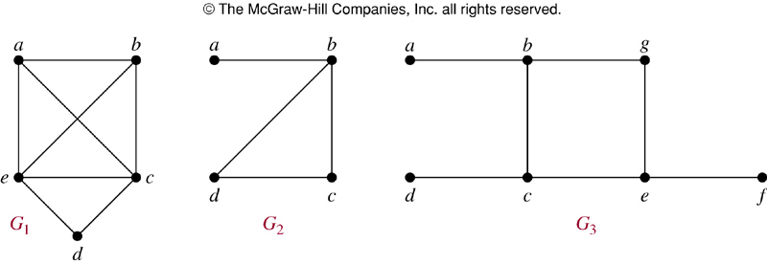
Hamilton Circuit
Ques:- Which of these three figures has a Hamilton circuit?
Or, if no Hamilton circuit, a Hamilton path?
Sol:- Lets do it one by one.

Slide 12
Hamilton Circuit
G1
Sol:- G₁ has a Hamilton circuit: a, b, c, d, e, a

Slide 13
Hamilton Circuit
Sol:- G₂ does not have a Hamilton circuit, but does have a Hamilton path: a, b, c, d
G2

Slide 14
Hamilton Circuit
Sol:- G₃ has neither.
G3

Slide 15
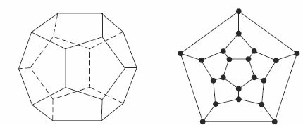
Hamilton Circuit
Dodecahedron puzzle and it equivalent graph
Ques:- Is there a circuit in this graph that passes through each vertex exactly once?

Slide 16
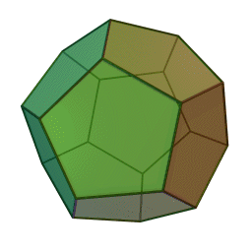
Hamilton Circuit
Ques:- Is there a circuit in this graph that passes through each vertex exactly once?
Dodecahedron is a polyhedron with twelve flat faces

Slide 17
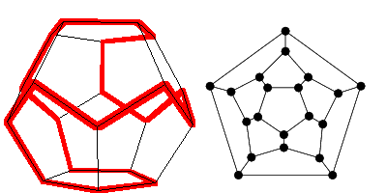
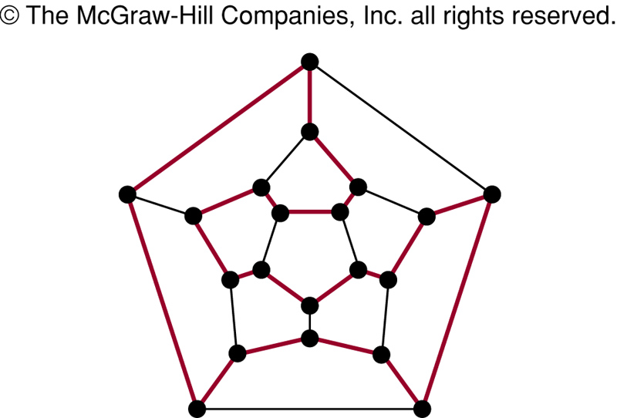
Hamilton Paths and Circuits
Yes; this is a circuit that passes through each vertex exactly once.

Slide 18
Properties to look for ...
No vertex of degree 1
If a node has degree 2, then both edges incident to it must be in any Hamilton circuit.
No smaller circuits contained in any Hamilton circuit (the start/endpoint of any smaller circuit would have to be visited twice).

Slide 19
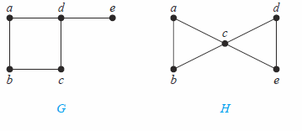
Hamilton Circuit
a
b
e
a
d
c
Sol:- There is no Hamilton circuit in G because G has a vertex of degree one: e.
G

Slide 20
Hamilton circuit?
a
d
c
b
e
Sol:- Because the degrees of the vertices a, b, d, and e are all two, every edge incident with these vertices must be part of any Hamilton circuit. No Hamilton circuit can exist in H, for any Hamilton circuit would have to contain four edges incident with c, which is impossible.

Slide 21
Summary
Property | Euler | Hamilton
Repeated visits to a given node allowed? | Yes | No
Repeated traversals of a given edge allowed? | No | No

